Slide 1

ZOMATO RESTAURANT ANALYTICS PROJECT

Slide 2
AGENDA
INTRODUCTION
DATA OVERVIEW
KPIs & ANALYSIS
DASHBOARD

Slide 3
INTRODUCTION
Welcome to the Zomato Data Analytics Project, where we explore key metrics of one of the world’s top food delivery platforms.
This study uses Zomato restaurant data, a popular platform for finding local eateries by cuisine, cost, reviews, ratings, and votes.
Zomato dataset shows restaurant ratings, votes, and costs—helping users find favorites and give reviews.
Introduction

Slide 4
DATA OVERVIEW
KEY FEATURES OF THE DATASET:
Restaurant ID – Restaurants Numbers
Restaurant Name – Name of the restaurant
City / Location – City where the restaurant is located
Cuisine – Types of food served
Average Cost for Two – Approximate dining cost for two people
Aggregate Rating – Overall customer rating
Votes – Number of customer votes received
Reviews – Customer feedback and comments
Online Order – Availability of online food ordering
Table Booking – Availability of table reservation
Country – Country where the restaurant operates

Slide 5
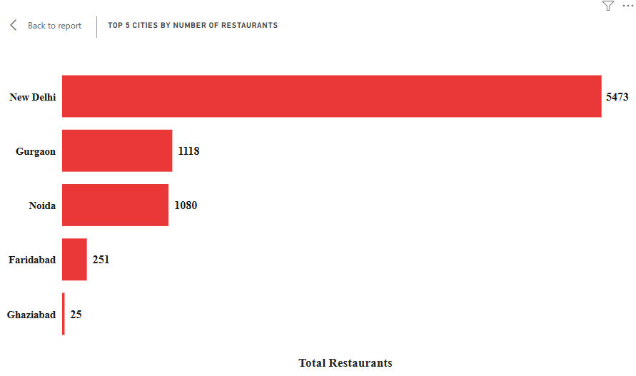
KPIs & ANALYSIS OVERVIEW
TOP 5 CITIES BY RESTAURANT COUNT
Highlights cities with the highest number of restaurants, showing market concentration.
Used to identify Zomato’s strongest demand hubs for expansion and targeting.

Slide 6
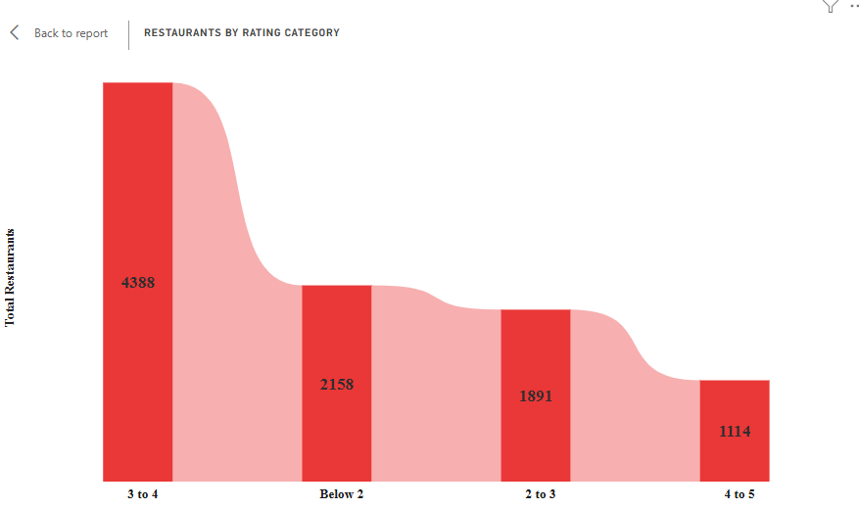
KPIs & ANALYSIS OVERVIEW
RESTAURANTS BY RATING CATEGORY
Shows restaurant count in rating buckets to assess overall customer experience spread.
Used to understand how many restaurants fall in low vs high satisfaction ranges.

Slide 7
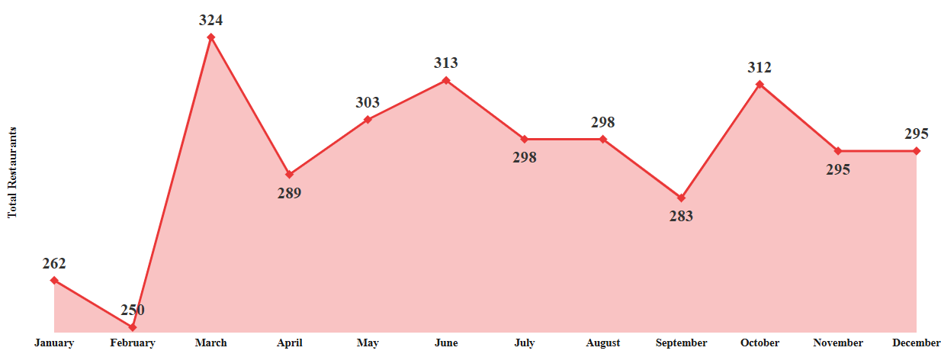
KPIs & ANALYSIS OVERVIEW
RESTAURANT OPENINGS TREND
Shows monthly opening patterns to track seasonality in onboarding restaurants.
Helps detect peak months where restaurant acquisition activity is highest.

Slide 8
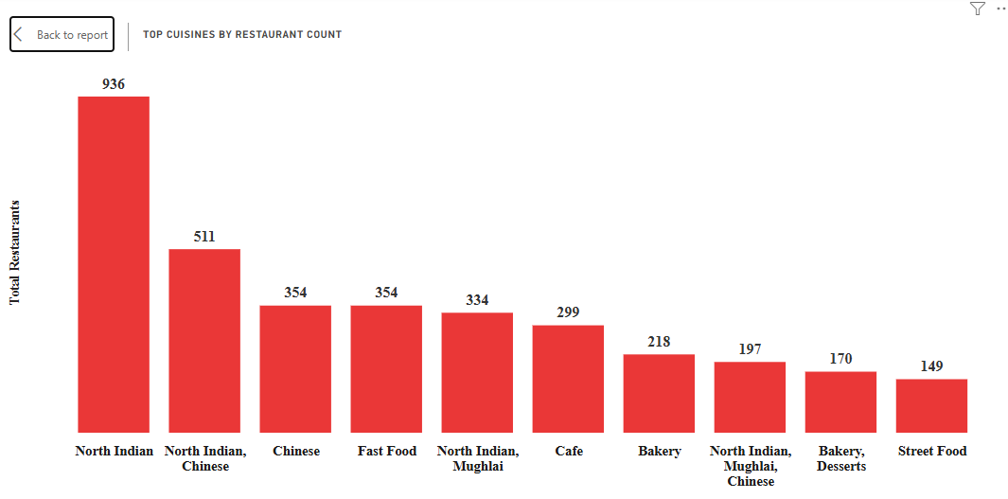
KPIs & ANALYSIS OVERVIEW
TOP CUISINES BY RESTAURANT
Shows the highest-listed cuisines by restaurant count, spotting demand clusters.
Used to understand cuisine-level acquisition dominance.

Slide 9
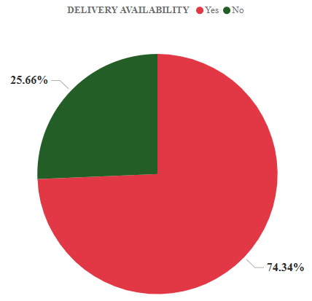
KPIs & ANALYSIS OVERVIEW
ONLINE DELIVERY AVAILABILITY (%)
Shows the percentage of restaurants offering delivery, measuring convenience adoption.
Used to understand delivery readiness across Zomato’s restaurant network.

Slide 10
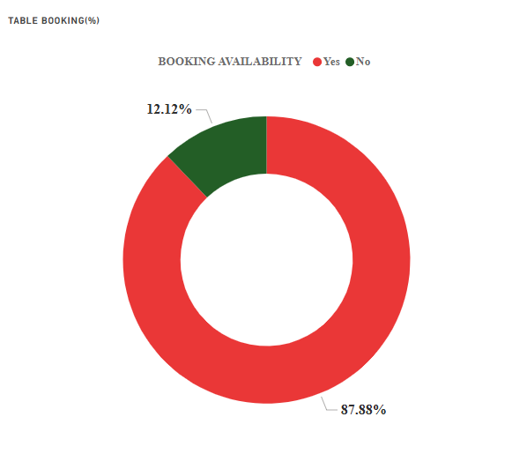
KPIs & ANALYSIS OVERVIEW
TABLE BOOKING AVAILABILITY (%)
Shows the percentage of restaurants supporting table booking, indicating dine-in demand.
Used to measure offline service adoption for reservation features.

Slide 11
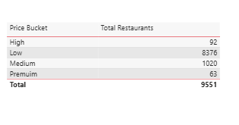
KPIs & ANALYSIS OVERVIEW
RESTAURANTS BY PRICE RANGE
Segments restaurants into price buckets, showing affordability and premium distribution.
Used to understand pricing diversity across markets.

Slide 12
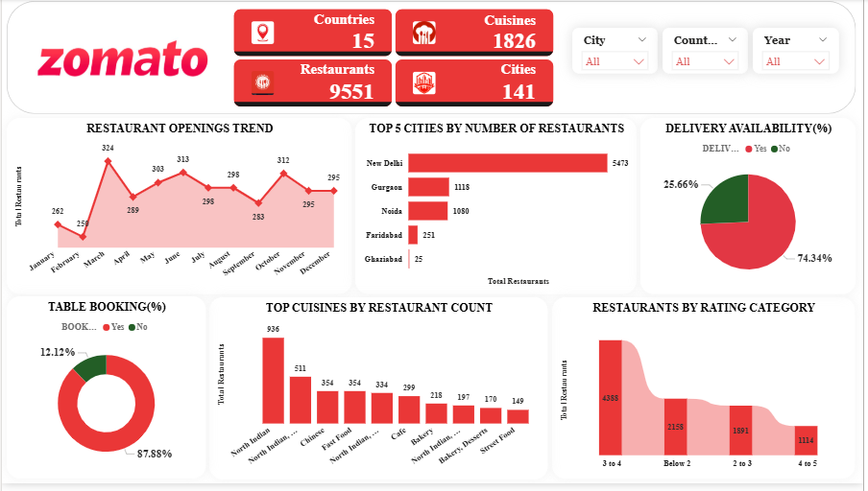

Slide 13
PROJECT SUMMARY
This is a data analysis project using the Zomato restaurant dataset. The goal is to study restaurant count, ratings, price levels, and services like delivery and table booking. We cleaned the data, made useful groups for ratings and price, and found key markets by city and country. We analyzed trends by year, quarter, and month to understand growth patterns. This project helps us understand customer choices and restaurant performance with clear data insights.

Slide 14
CONCLUSION
Made Zomato data into a clean Power BI dashboard.
Used rating and price groups to show clear meaning.
Found top cities and top food types that customers like.
Saw growth every year and every month.
Checked delivery and table booking in percentage.
Added slicers so clear numbers change when we filter.
Dashboard gives insights for better planning

Slide 15
Thank you

